Slide 1

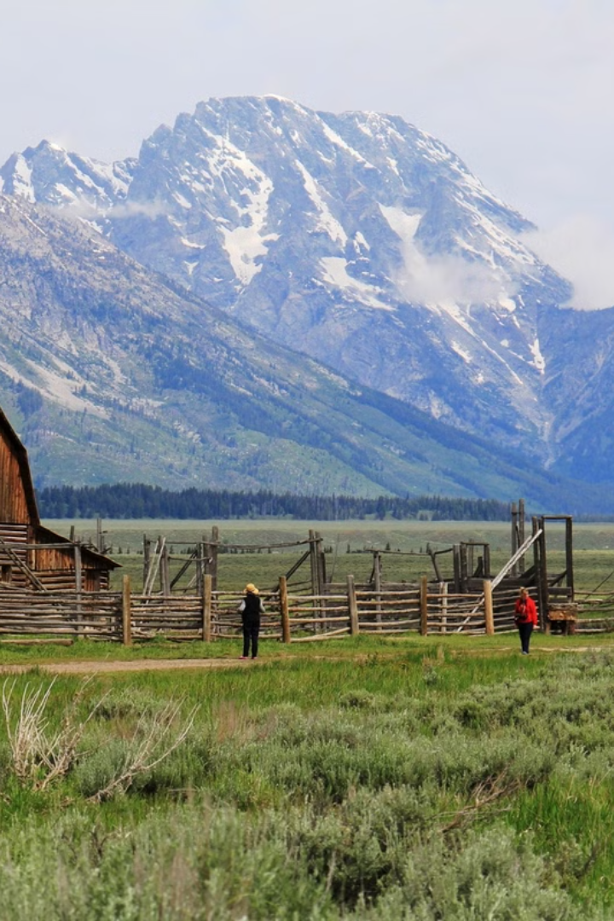

AgroQuality: Empowering Farmers and Freelancers
AgroQuality is a comprehensive website that revolutionizes the way we assess farm quality and connect freelancers with agricultural assessing opportunities. By leveraging cutting-edge technology and a user-friendly interface, freelancers can create their client's farm thorough assessment report and provide a service to the farmers based on instructing them what they needs to practice on their farm to improve farm's health.

Slide 2
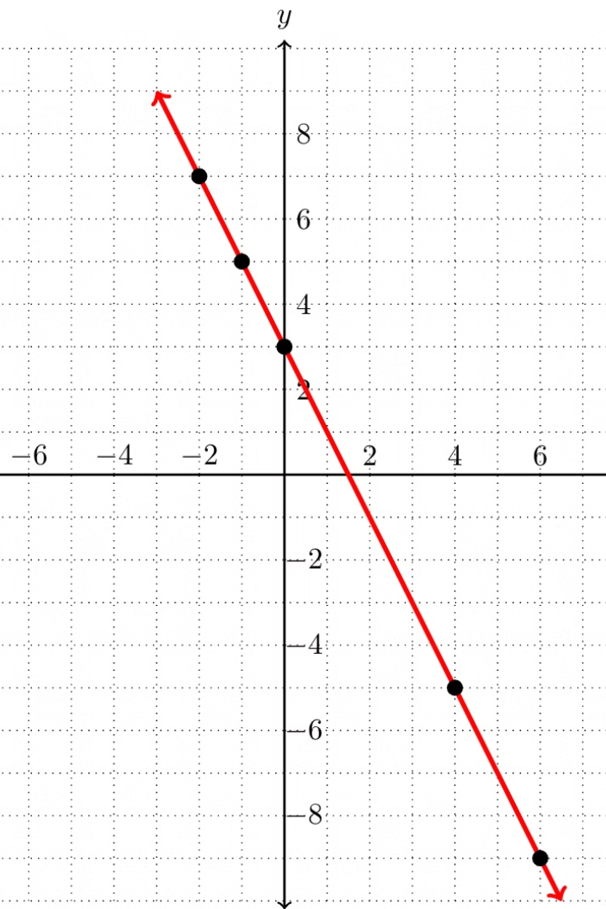
AgroAPI: Farm Quality Assessments
1
AgroAPI:
AgroQuality integrates AgroAPI seamlessly with farm details, enabling real-time data collection and analysis for comprehensive quality assessments.
2
Precision Insights
AgroAPI leverages advanced algorithms to provide freelancers with detailed insights into their operations, like soil data, uvIndex , weather data …etc

Slide 3
Checking Farm Quality: The AgroQuality Website Experience
Intuitive Interface
Comprehensive Assessments
Personalized Recommendatios
The AgroQuality website offers a user-friendly interface, making it easy for freelancers to navigate and access the platform's comprehensive features.
Freelancers can input detailed information about their client's farm details, and the platform provides thorough assessments of their farm's quality, productivity, and sustainability.
Based on the assessment results, AgroQuality offers customized recommendations to help farmers improve their practices and maximize their farm's potential.

Slide 4

Applying for freelancing and using website features to create guidance service :
Job Postings & Creating guidance service
AgroQuality features a robust freelancing opportunity where freelancers can pay a nominal fee of website services and after that can create a project where they can input farm details and can get a complete farm assessment as a response, after that they can provide a instruction service to the farm owners(farmers) guiding them what practices they should perform to maintain good health of their farms.

Slide 5




Advantages of the AgroQuality Platform
Efficiency
AgroQuality streamlines farm quality assessments and service creating processes, saving farmers and freelancers valuable time and resources.
Precision
The platform's advanced analytics and data-driven insights enable freelancers to make guidance service to farmers so that farmers can make informed decisions and optimize their operations.
Sustainability
By promoting best practices and creating employment opportunities, AgroQuality contributes to the long-term sustainability of the agricultural sector.

Slide 6

Scalability and Growth Potential
Expanding Reach
Partnerships and Collaborations
AgroQuality plans to extend its services to farmers and freelancers worldwide, ensuring broader impact and growth opportunities.
AgroQuality aims to forge strategic partnerships with agriculture experts and government agencies, further expanding its influence and opportunities.
1
2
3
Technological Advancements
The platform will continuously enhance its technology, integrating cutting-edge innovations to provide even more robust and reliable assesment and services.

Slide 7
Team's First 6 Hours: Building the AgroQuality Website Skeleton :
Backend (Completed Backend Fully) :
Frontend (Created Basic Design and UI) :
Initialized the backend using Prisma and Hono, after that we created schemas like Employee(freelancer), Farmer and Projects and applied necessary relations to them. We created routes for users(freelancers) and farmers(their clients) and added crud database operations to the routes, we also at the last deployed the backend to cloudflare workers.
Created basic components like navbar, footer, sidebar, hero section, sign up & sign in input form component … etc. After that we created basic pages like home page, signup & signin page and profile page. After that we created navigations to every page and links so that user can explore the website smoothly and can understand our services.

Slide 8
Team's Next twelve Hours: Problem Solving and Adding Functionalities
User Authentication & Subcribtion page
Implemented secure user authentication, including sign-up, sign-in, and password verification functionality, ensuring a seamless experience for website users. Also we added subscription system where freelancer can buy our website service to do farm assessments.
Profile System & Integrating backend with frontend
Added a profile system where user can set his/her profile and can update the profile whenever he/she wants. Also we integrated the frontend with backend and made the website fully functional.
1
2
3
Project Management Page & API Integration
Developed a project management system that allows freelancers to create, track, and collaborate on projects, ensuring efficient guidance service to farmers. We also itegrated AgroAPI with our frontend and backend and at last we made our website responsive.

Slide 9

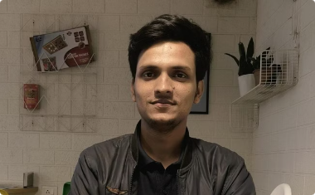
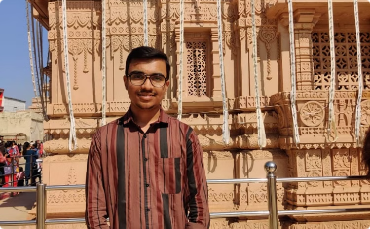

Meet the AgroQuality Team
Ansh Patel
Yash Mishra
Yash Prajapati
Siddhant Kotak
Thank You for Joining Us!
We're excited to have you onboard and look forward to empowering farmers and freelancers to achieve greater success. Your support is invaluable as we continue to grow and innovate.

